Slide 1


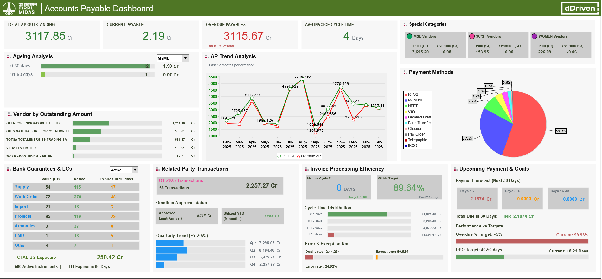
Data drives Excellence
Transforming Operations Data Into Strategic Advantage
Recovering LPO (Lost-profit Opportunity) with Enterprise Data-Twin — The AI Playbook for Chemical Operations

Slide 2
AGENDA
Presenter – Partha Ray
dDriven – Company Profile
Our “Fundamental First” Approach
Fundamental 1st Approach: Example #1
Fundamental 1st Approach: Example #1
Explanation – Oversight – Insight – OpsGPT – Foresight – Agent-X
Demonstration (Video of deployed solutions)
LPO – Lost Profit Opportunity

Slide 3
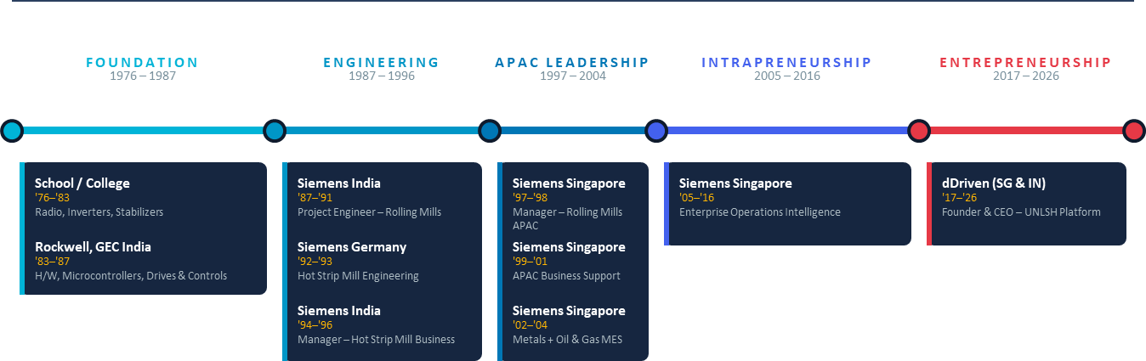
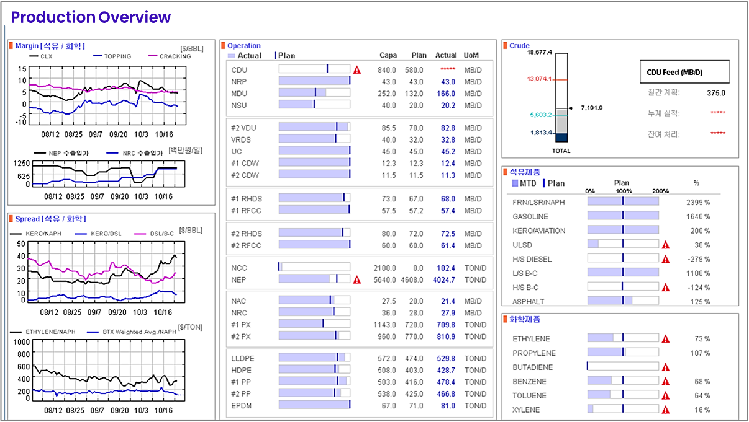
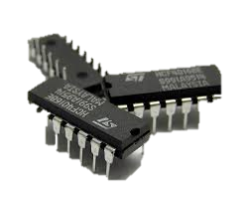
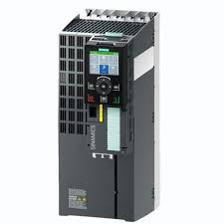
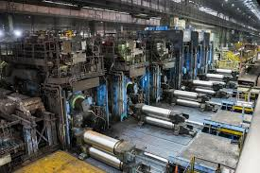
Partha Ray
INDIA
GERNAY / SINGAPORE
INDIA

Slide 4
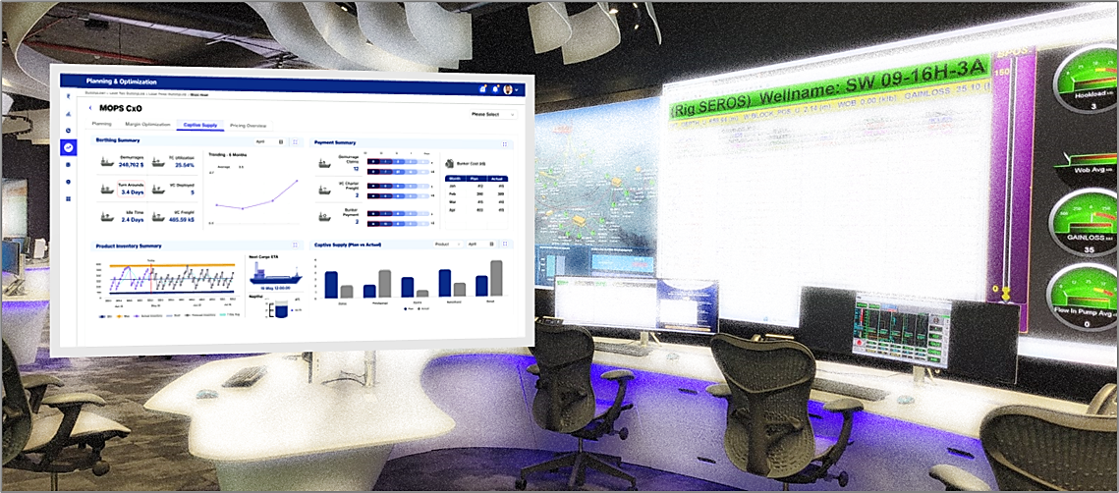






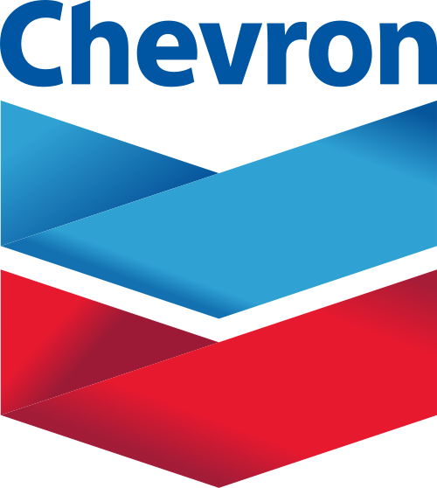


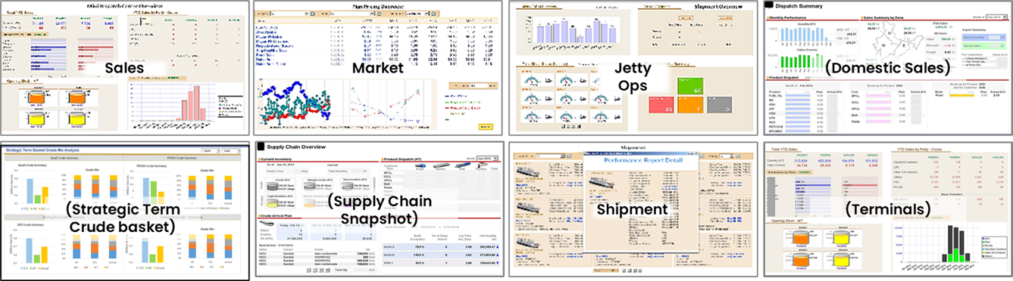








Introduction
Project Examples
Customers
Enterprise-wide Supply Chain and Business Command Centre for a Fortune 50 Major,
Cross-functional insights across trading (physical and paper), logistics, sales, finance, etc. ops.
Spanning across multiple BUs, plants & facilities worldwide.
400+ analytical dashboards providing insights to every stakeholder from the Chairman to storage depot operator.

Slide 5

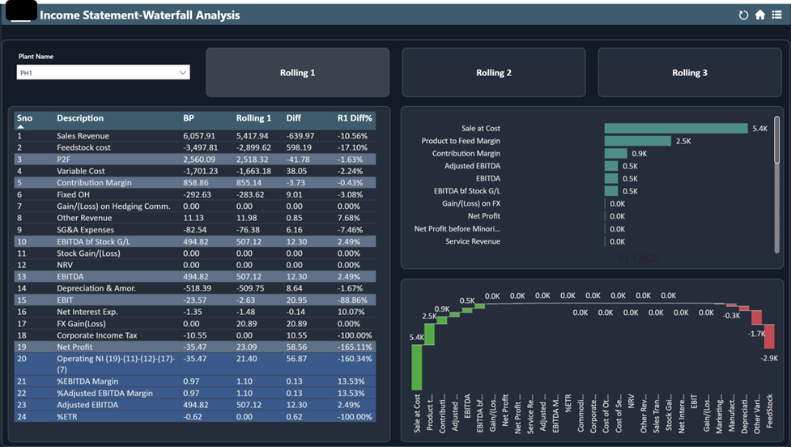
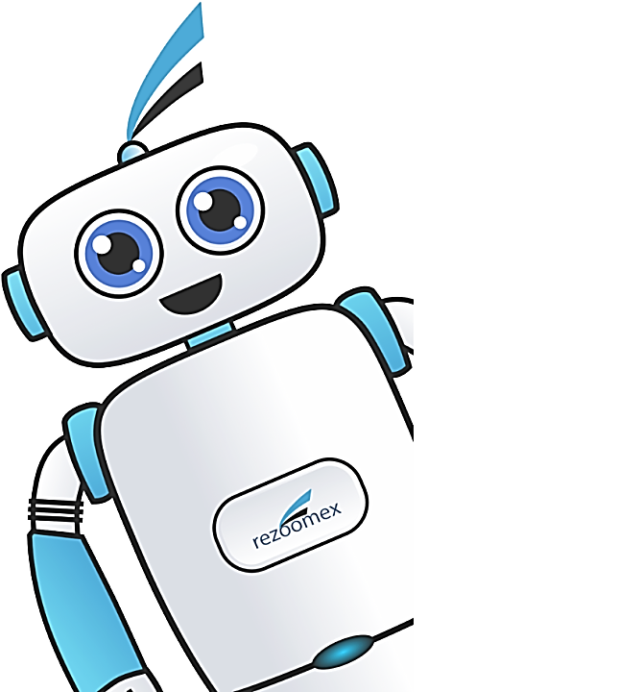
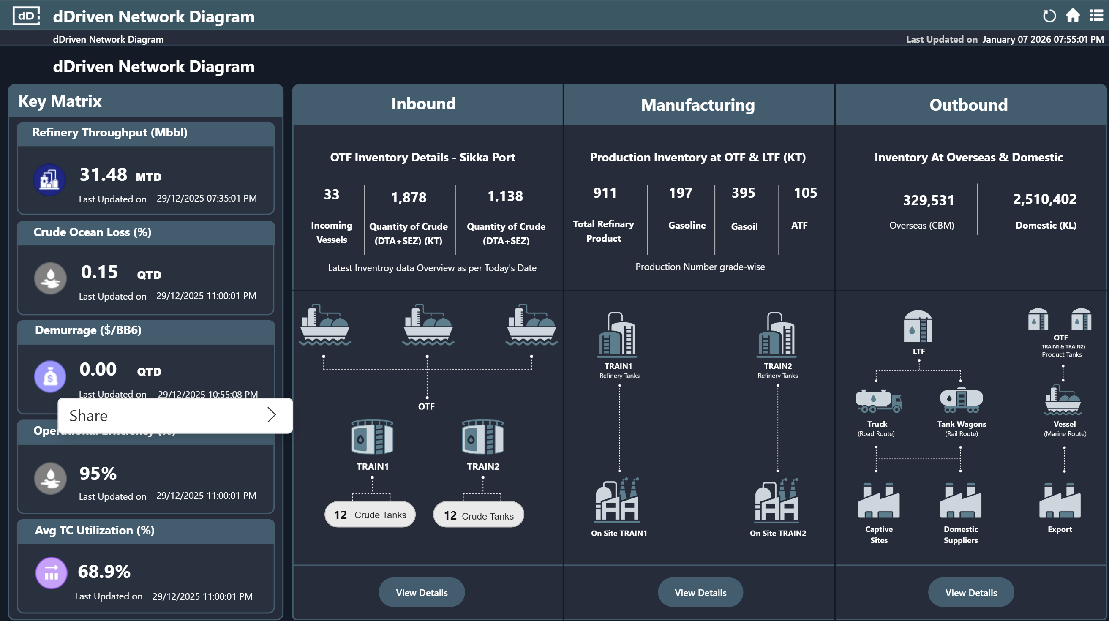
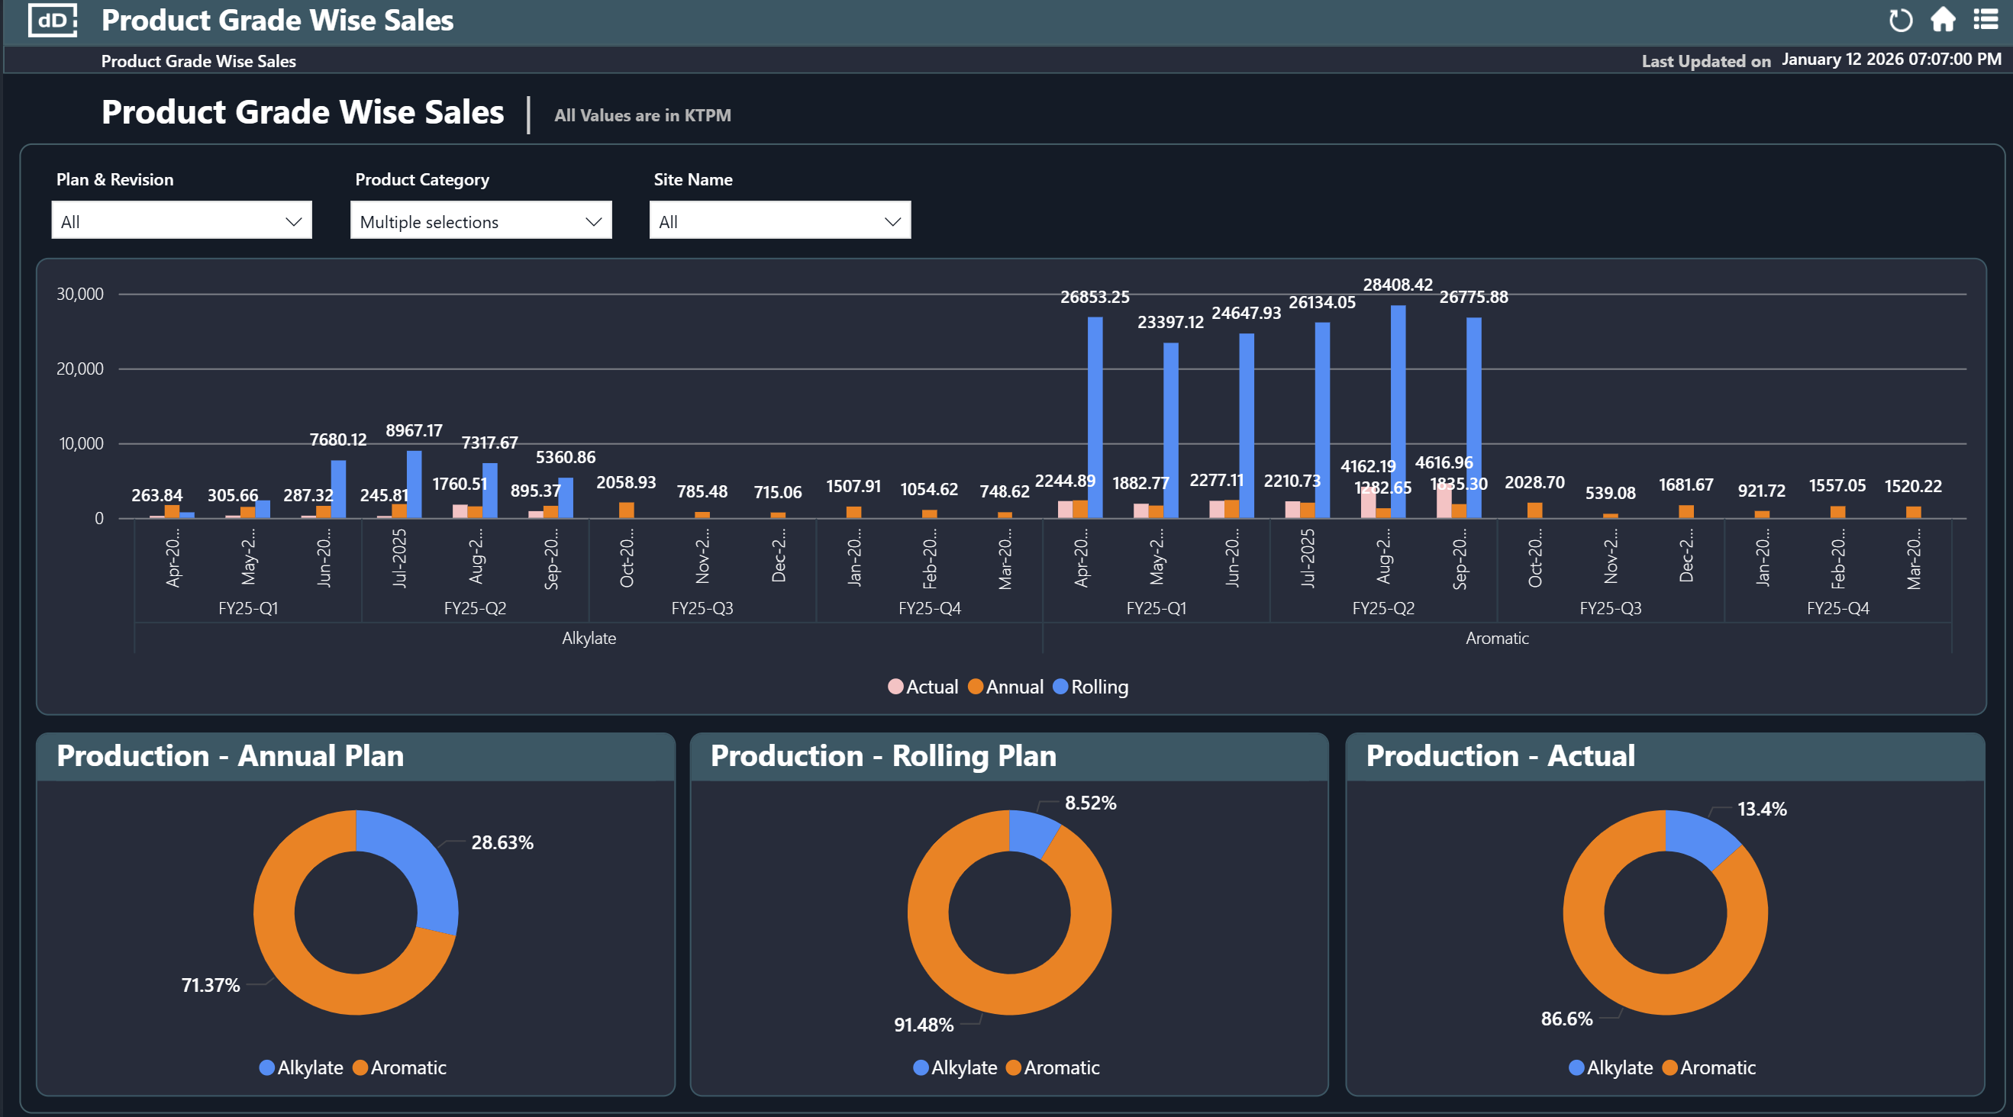

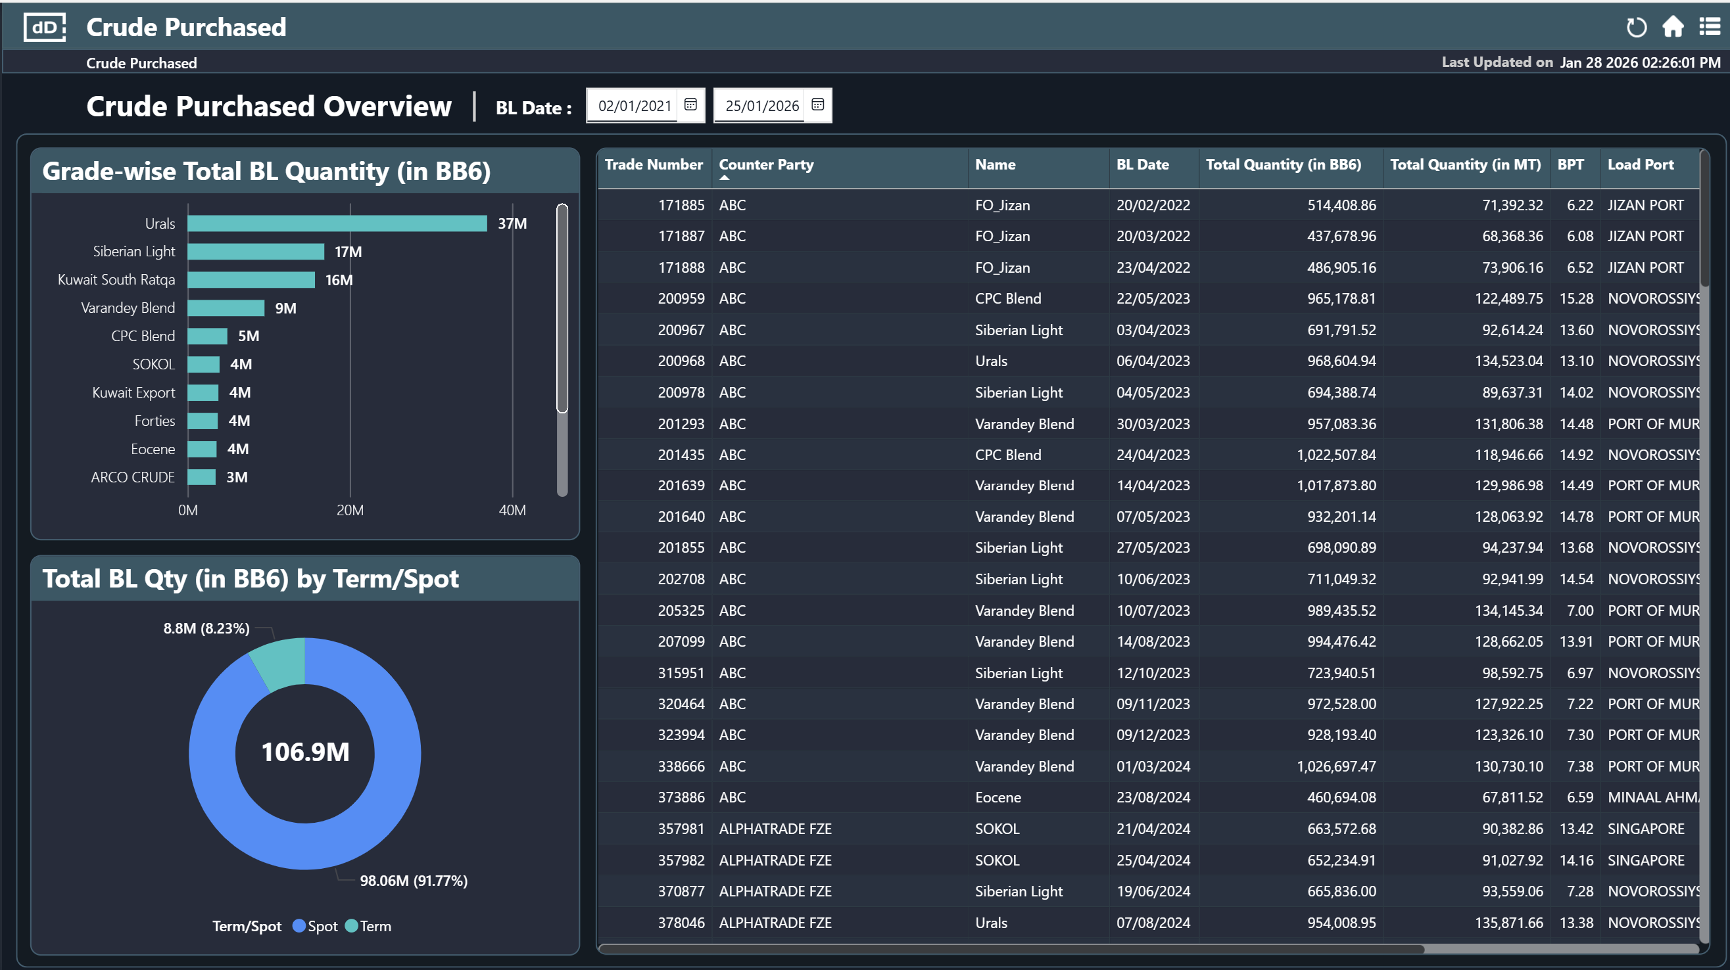
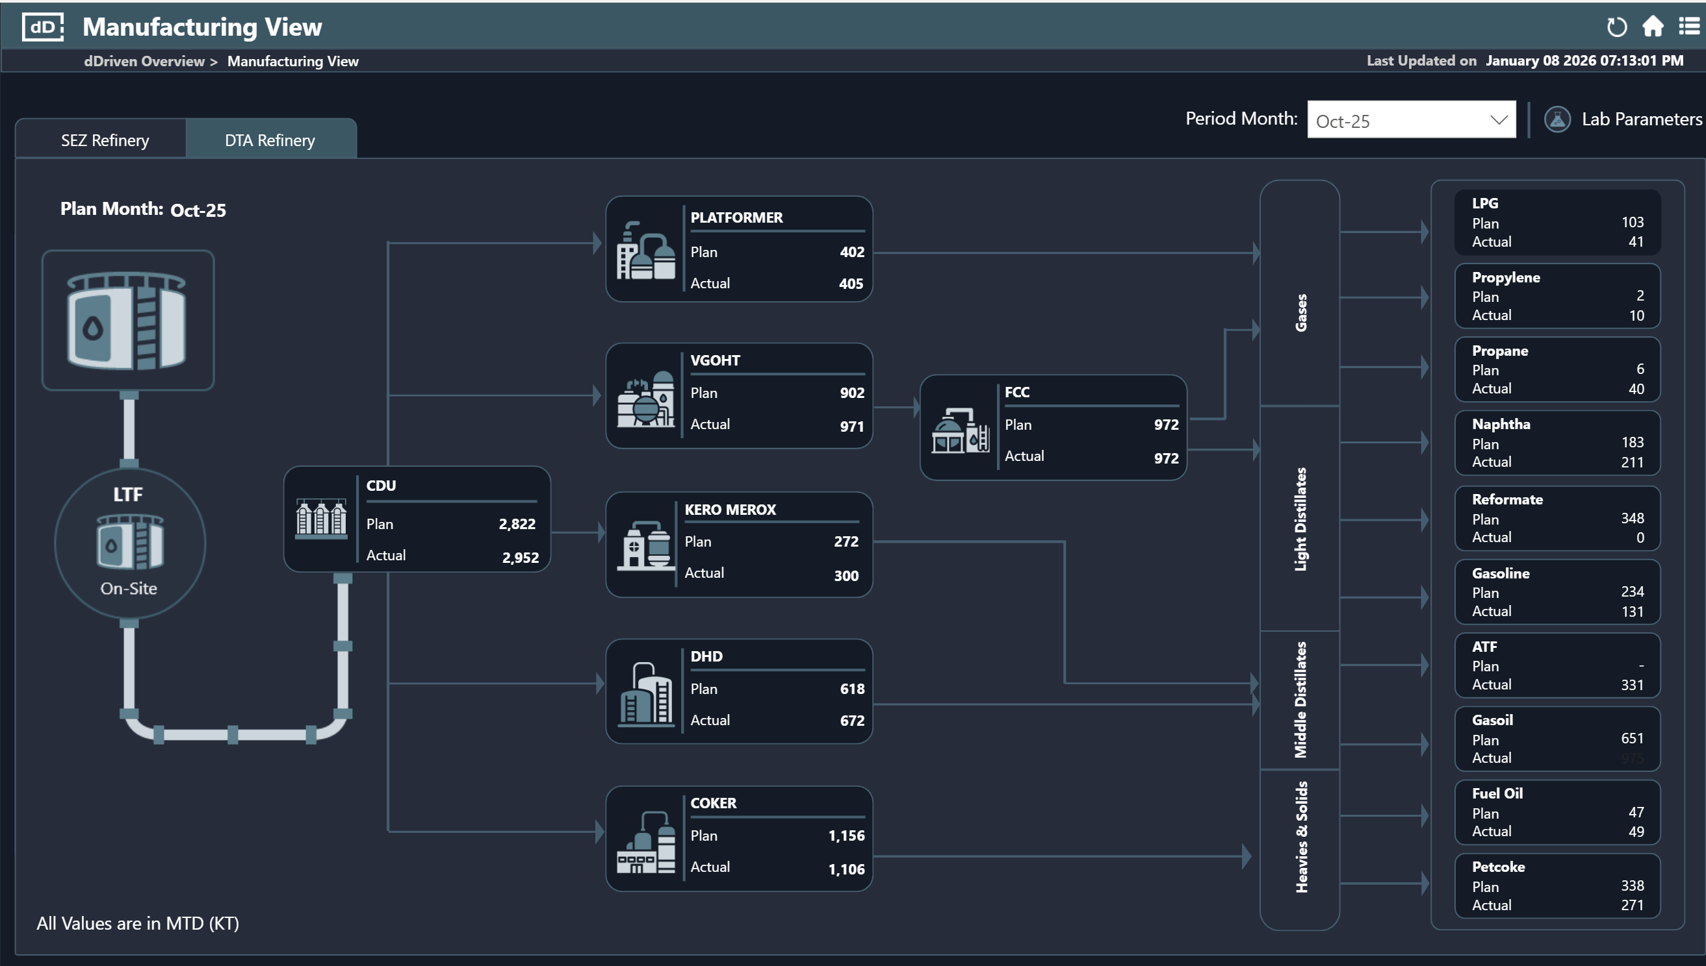
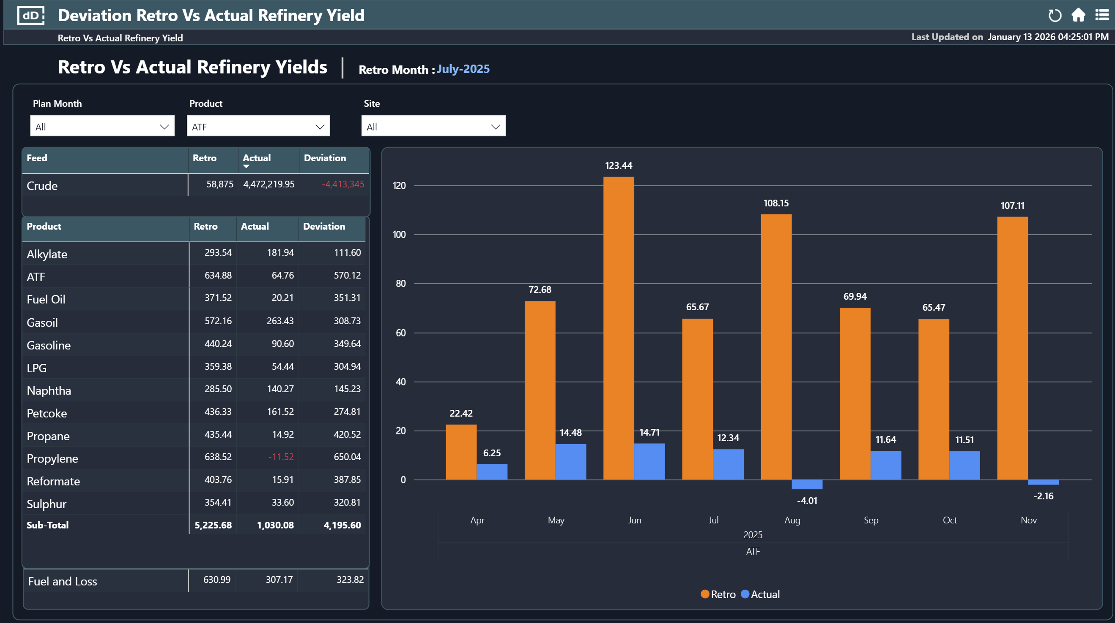
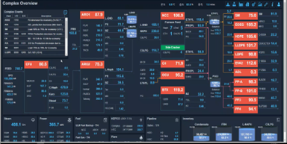
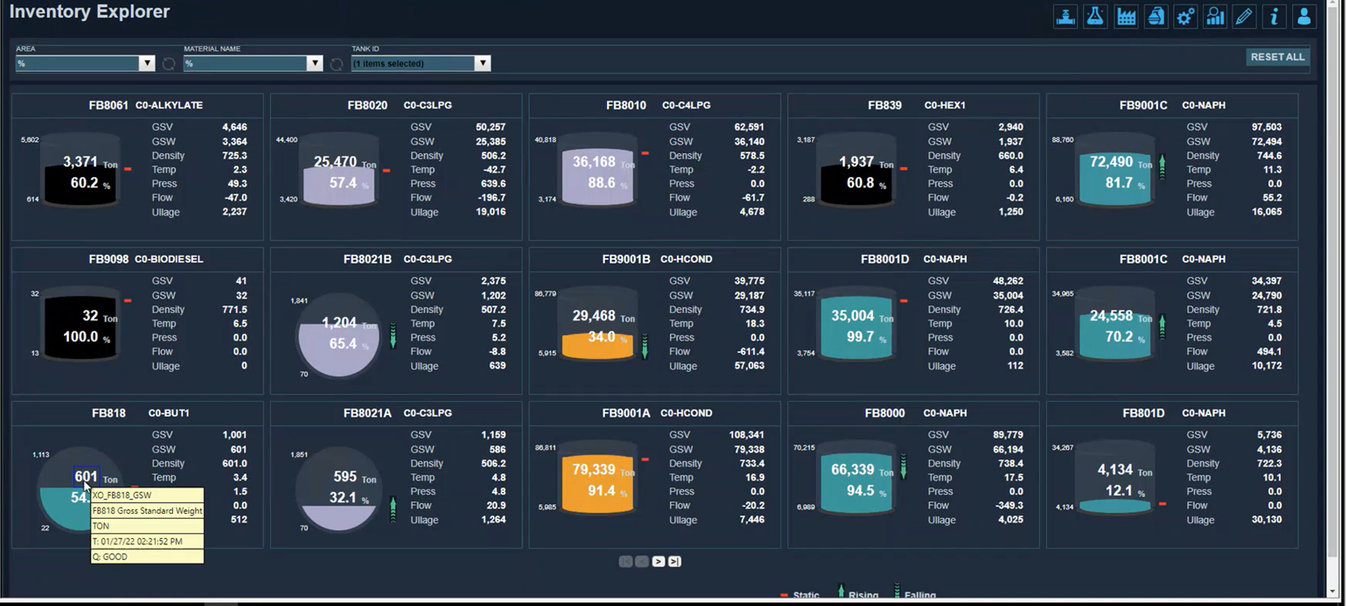
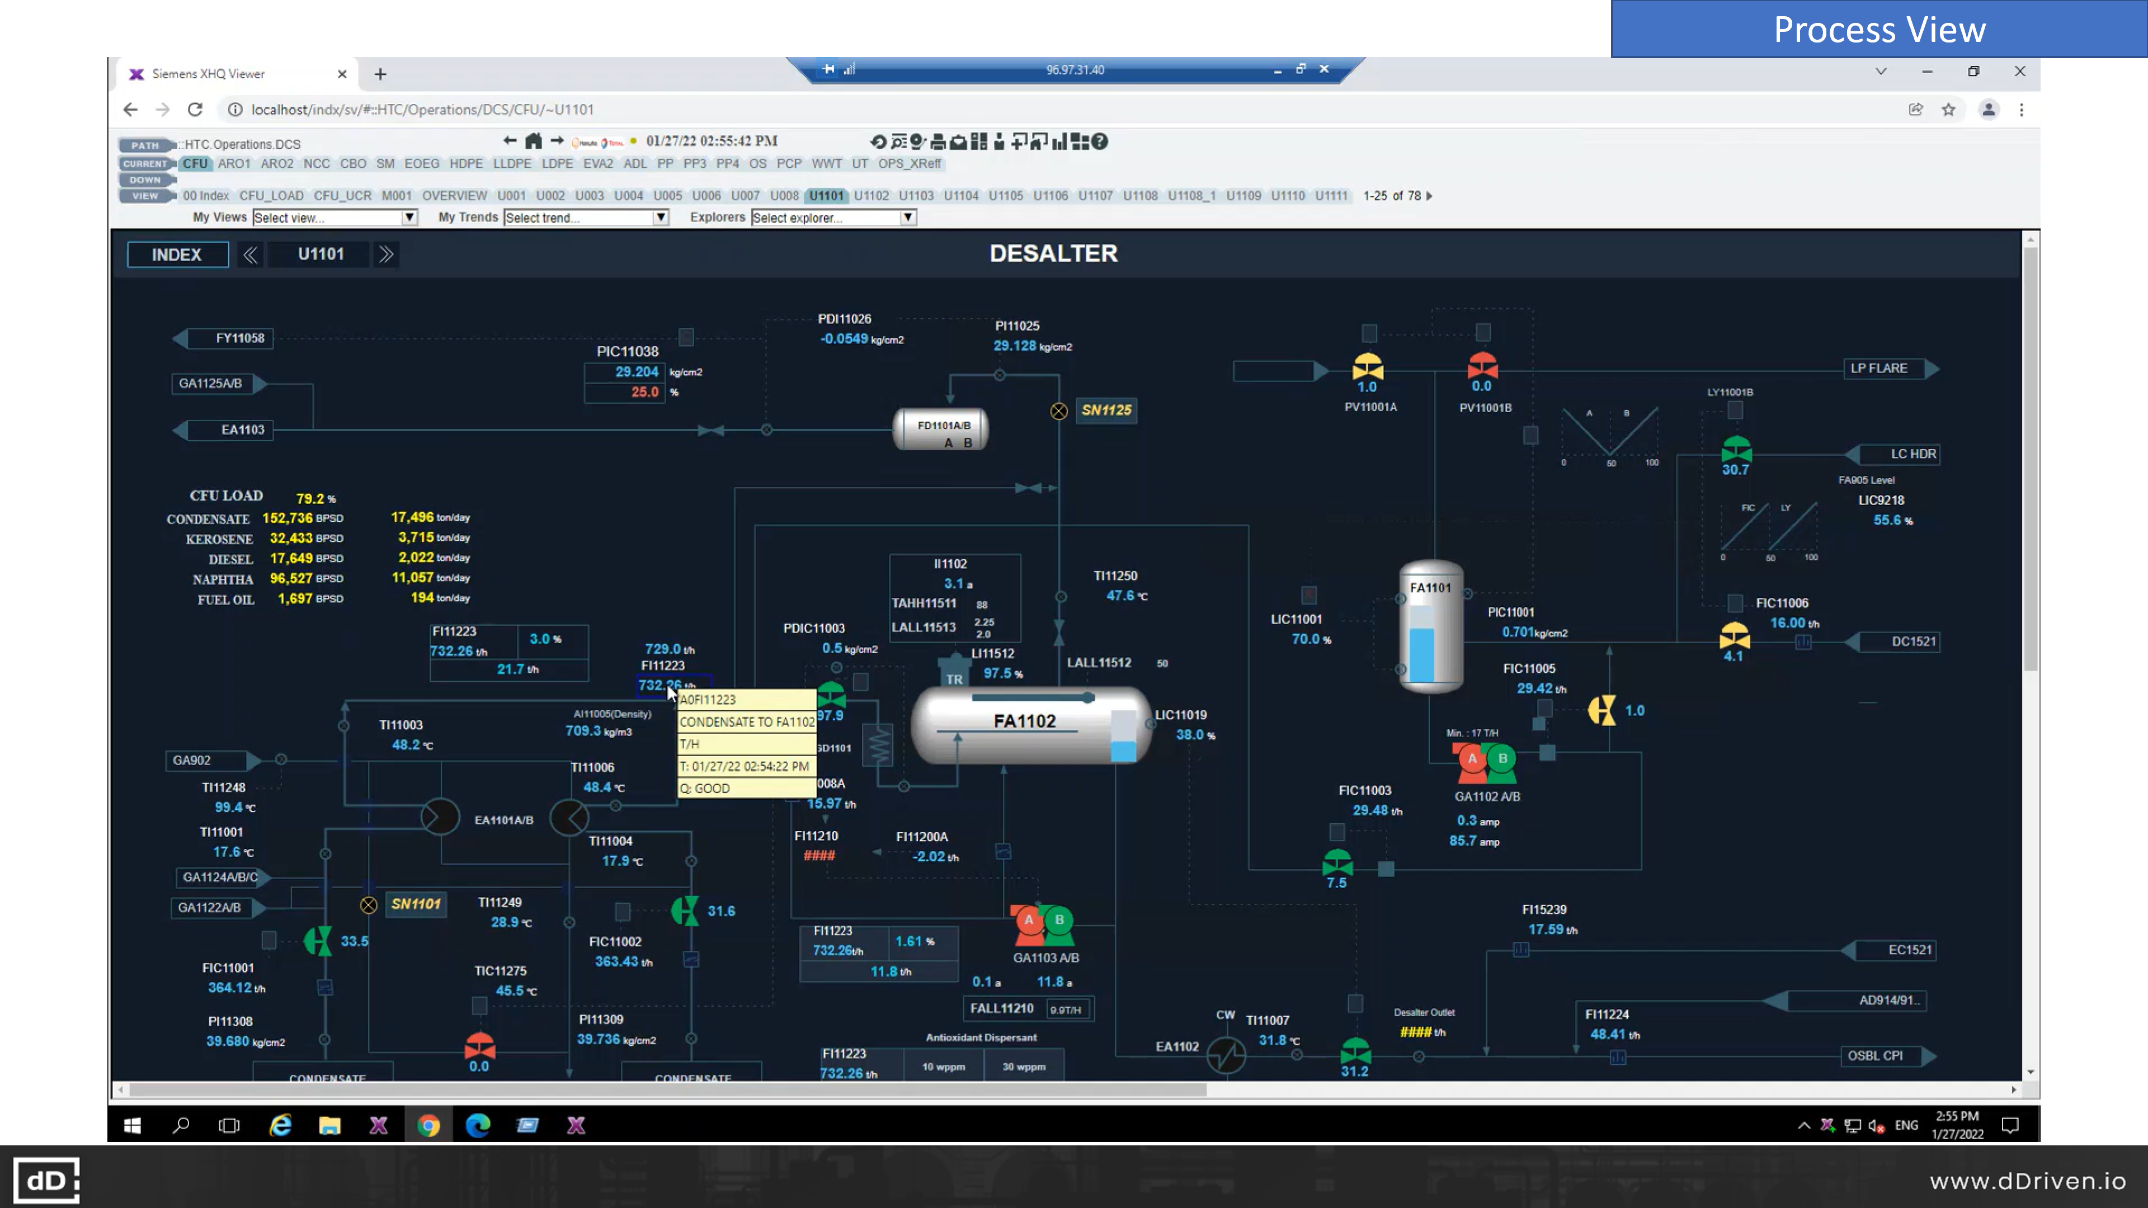
Our Approach – “Fundamental First”
Dashboards = FAQ
Ask me anything about your business or operations?
Your IT/OT Data
A truly Neutral Data Foundation
Finance, Corporate KPI
ANY IT/OT/ET Data sources, agnostic of vendor
ANY Data Hosting - Cloud / Air-gapped - agnostic of vendor
ANY Data consumers - vendor agnostic
Live Enterprise Data Twin – Use-case agnostic
Dahej
Ankleshwar
Bharuch
Vadodara
Surat
Vapi
Jurong
Island
DAESAN,
Korea
YEOSU,
Korea
Finance, Corporate KPI
Finance, Corporate KPI
Manufacturing Ops
Drives ANY AI Platform, Visualization / simulation / optimization tools
Plant Floor Process ops

Slide 6
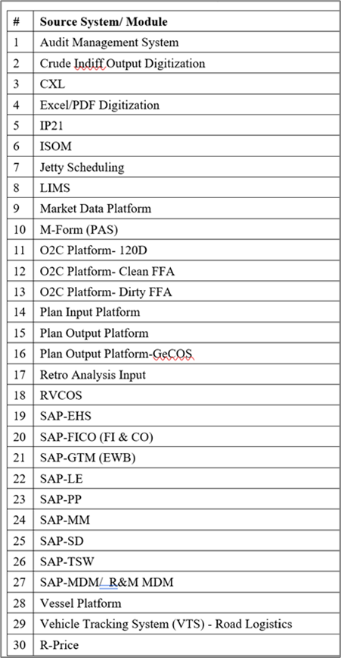
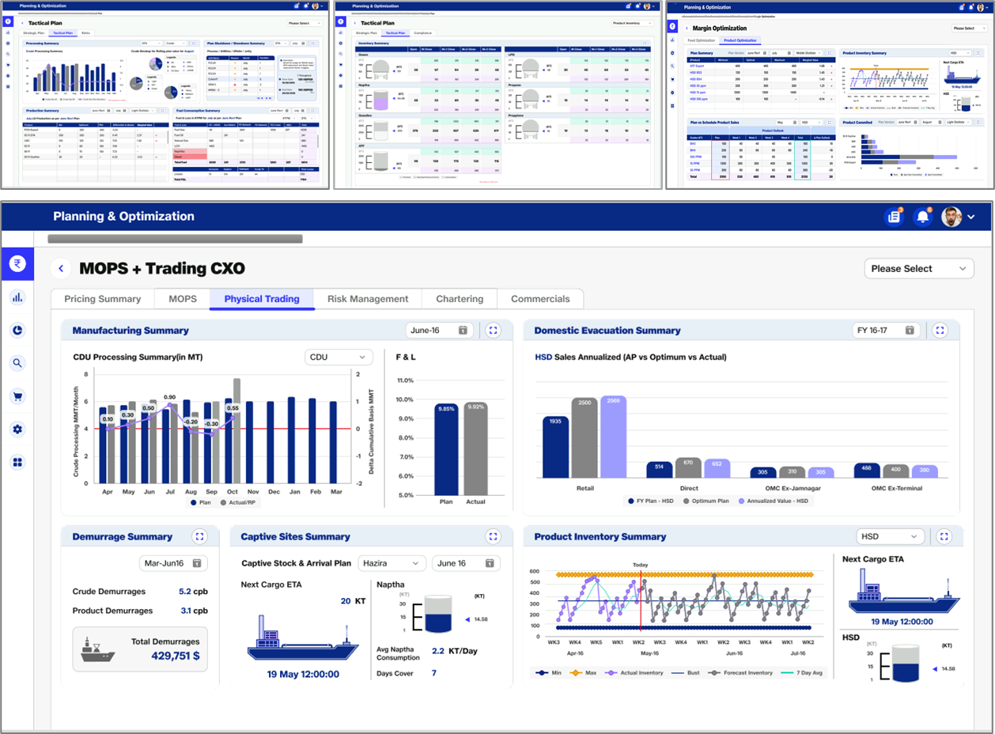
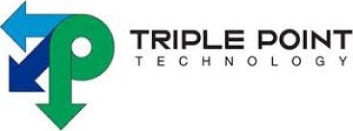


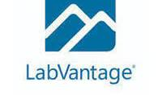


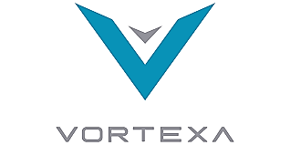
Fundamental 1st Approach: Example from a Fortune 500 Hydrocarbon major
200+ core leadership KPIs
300+ Power BI (MS Fabric) dashboards
UNLSH
(neutral Data Fondation)
Finance
Physical Trading
Paper Trading
Sales & Distribution
Logistics (Sea, Road, Pipelines)
Planning & Scheduling
Manufacturing
30+ IT/OT
Curate Data to AI/ML teams through API
Confidential, to b shared within the organization on need basis)

Slide 7
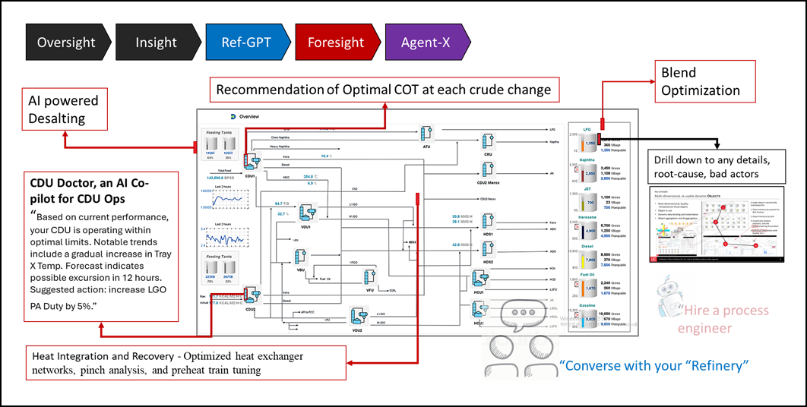
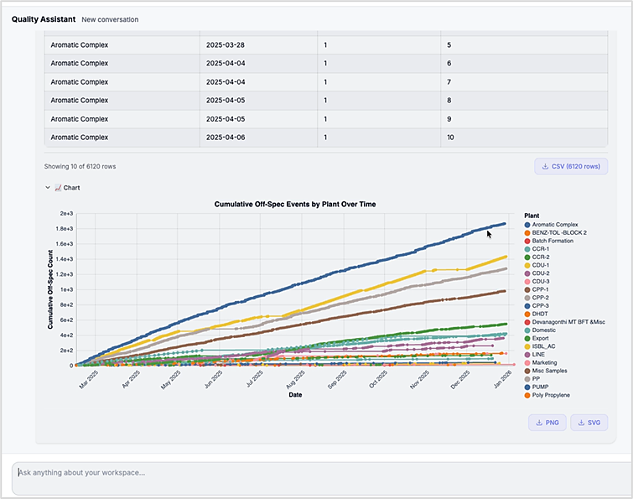
Fundamental 1st Approach: Example from a Large Indian Petroleum Refinery
Ask me anything about Quality
An end-to-end Digital Refining Solution delivered to a large Refinery — designed to serve every stakeholder, from the CMD to the Process Engineer, through three core capabilities:
Comprehensive Real-Time Oversight — encompassing Situational Awareness, On-Demand Insight, and Foresight across refinery operations.
Refinery-GPT (ChatGPT for the Refinery) — an integrated AI interface where users can ask natural-language questions about their area of work, such as: "Provide the Mark-to-Market valuation of the current Crude Oil inventory."
Autonomous AI Agents — purpose-built to execute operational tasks such as inventory reconciliation, shift-handover log preparation, and more.
I create shift hand-over document.
I monitor Emission, submit statutory rprt.
I optimize QGA & Demurrage
I optimize inventory & W. Cap.

Slide 8
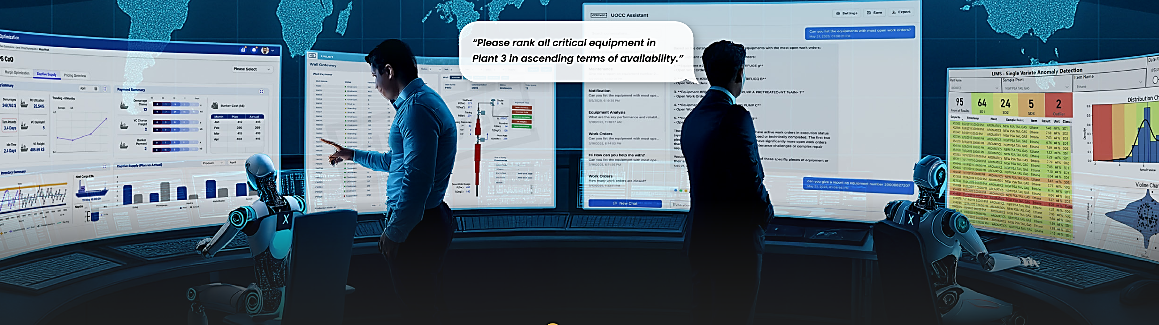
Oversight – Agent-X: From the users perspective
Oversight
Real-Time dashboards with KPIs, slice & dice, exceptions & excursion alters (Situational Awareness)
Insight
On-demand drill-down to details to details and bad actors
OpsGPT
LLM based chat interface to explore, query and reason across business, manufacturing, logistics Ops
Foresight
AI/ML based anomaly detection, forecasting, optimization, etc.
Agent-X
Agentic counterparts of process, maintenance, reliability, finance, etc. engineers.
Agent-X

Slide 9
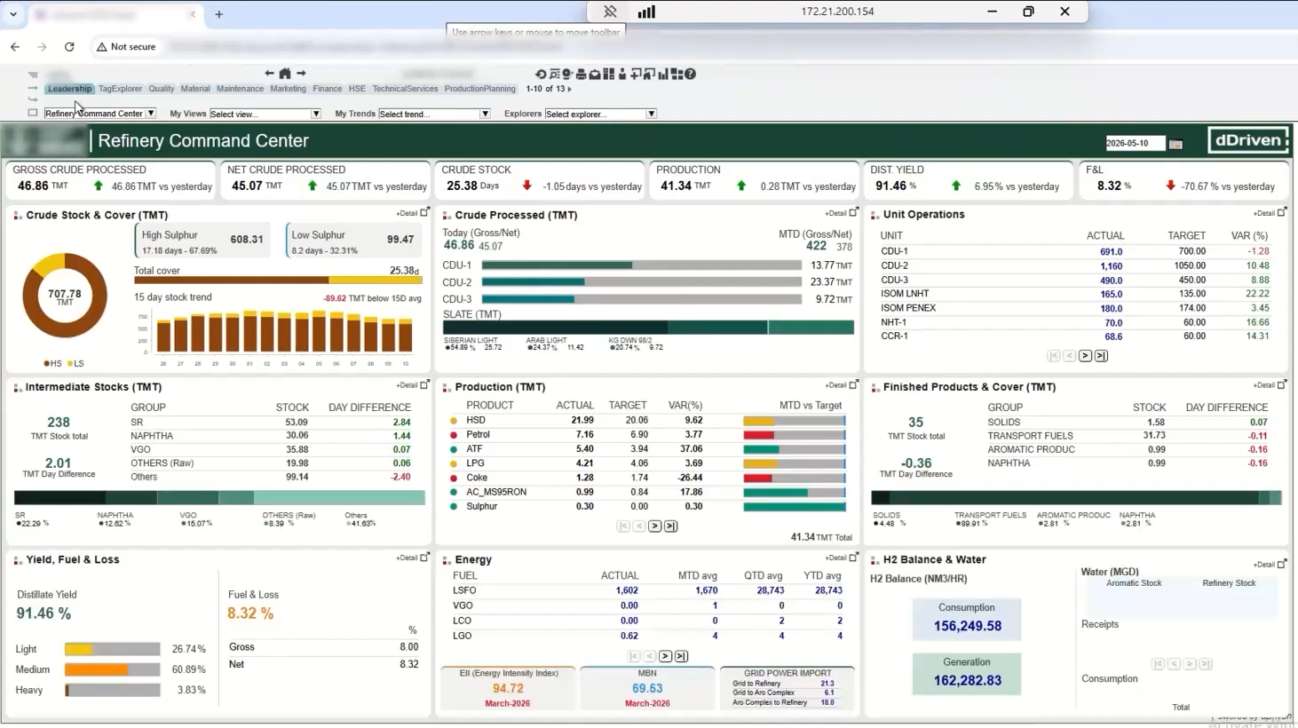
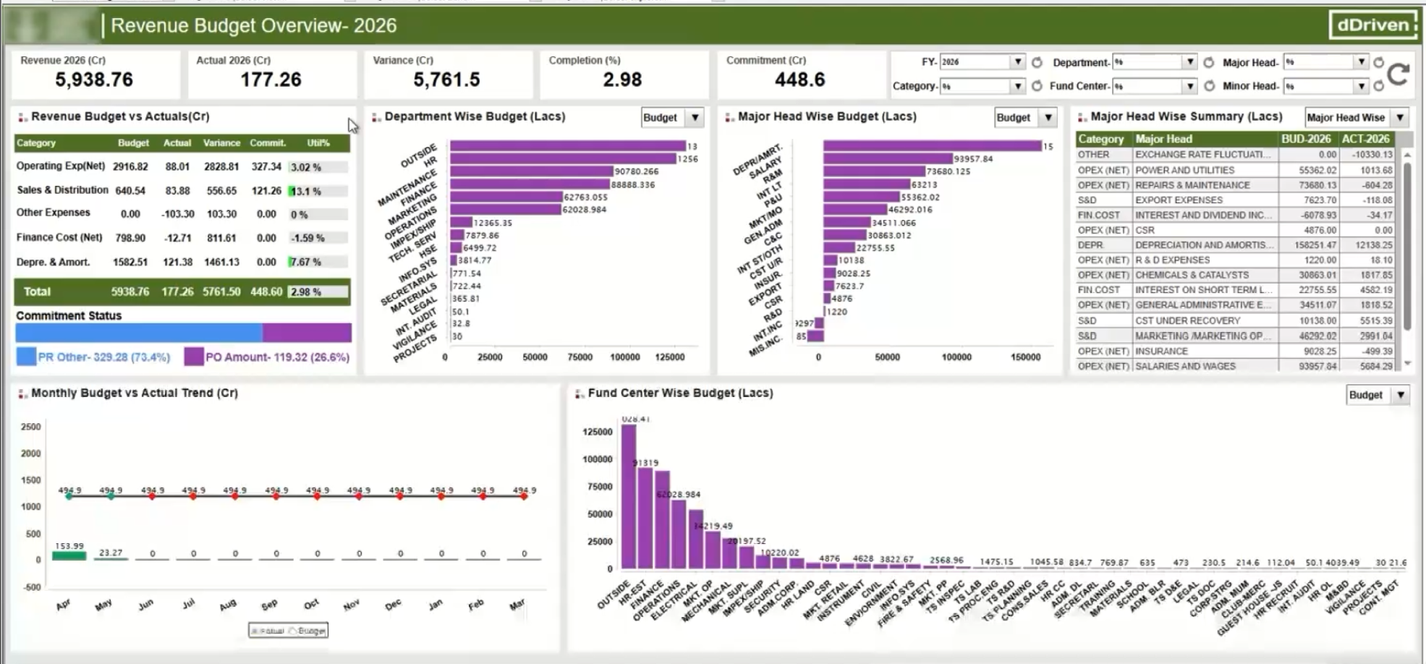
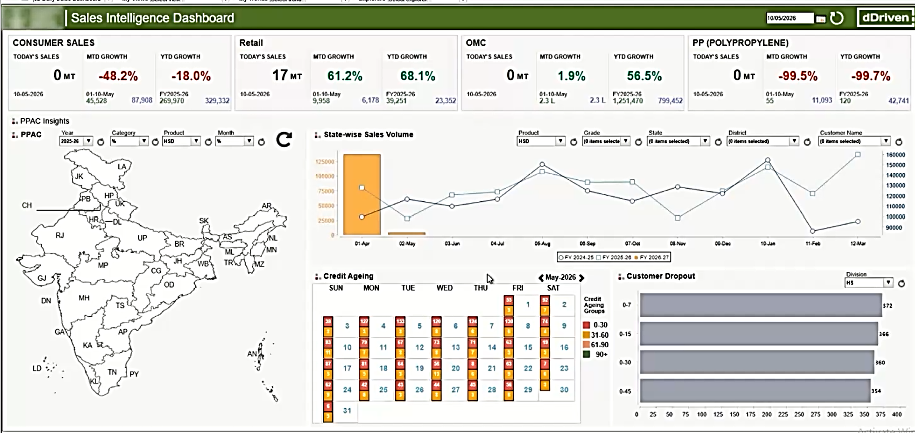
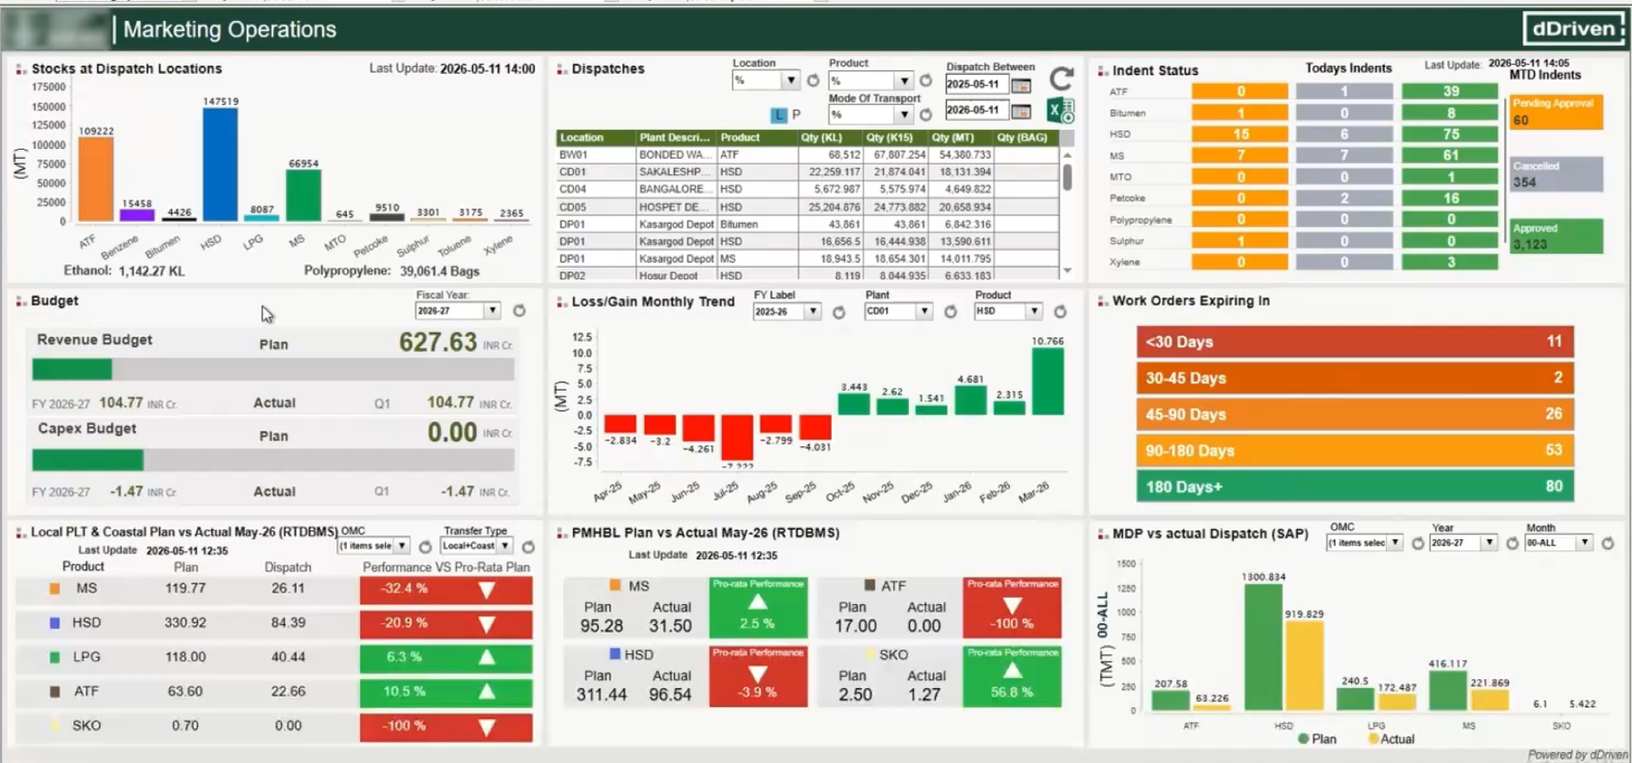
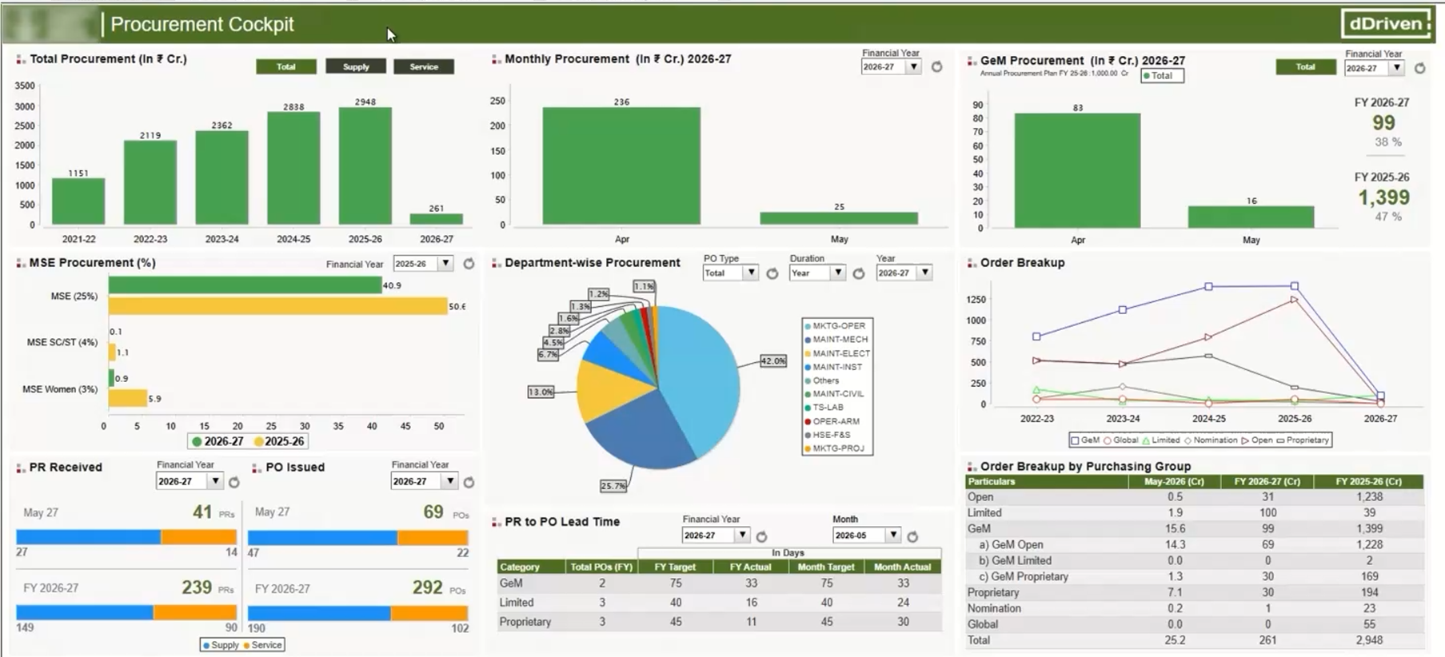
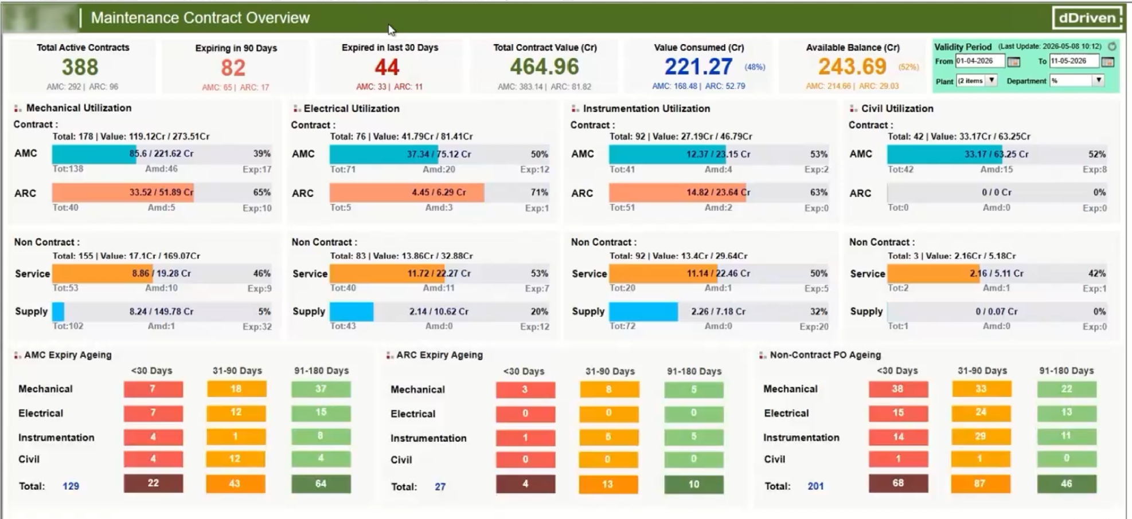
Solution (FAQ) Example (Video) from a Large Indian Petroleum Refinery

Slide 10
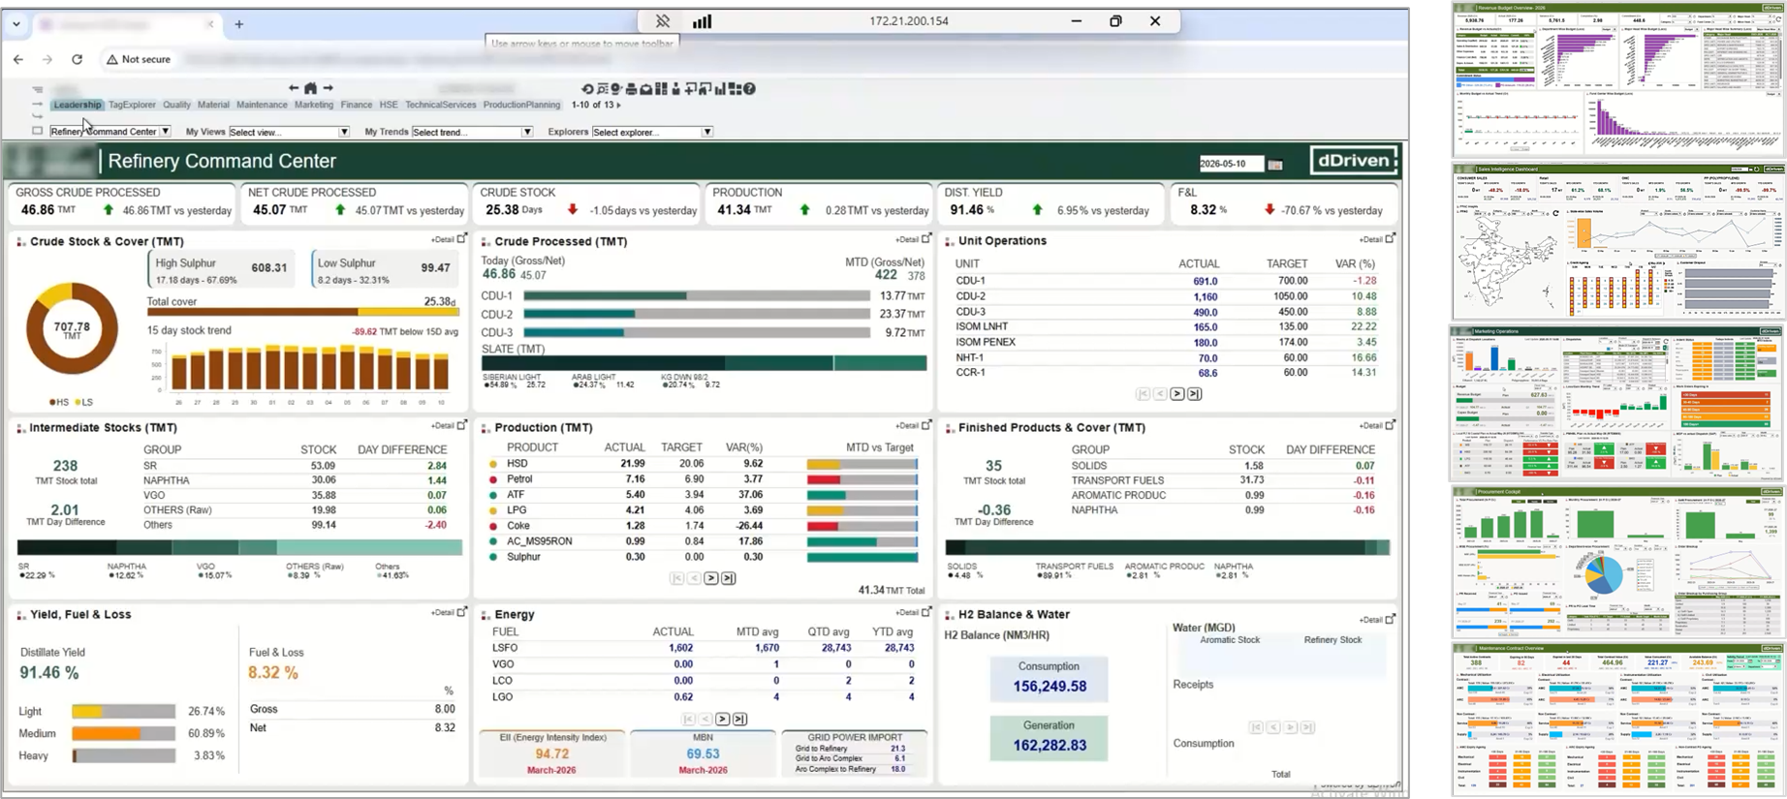
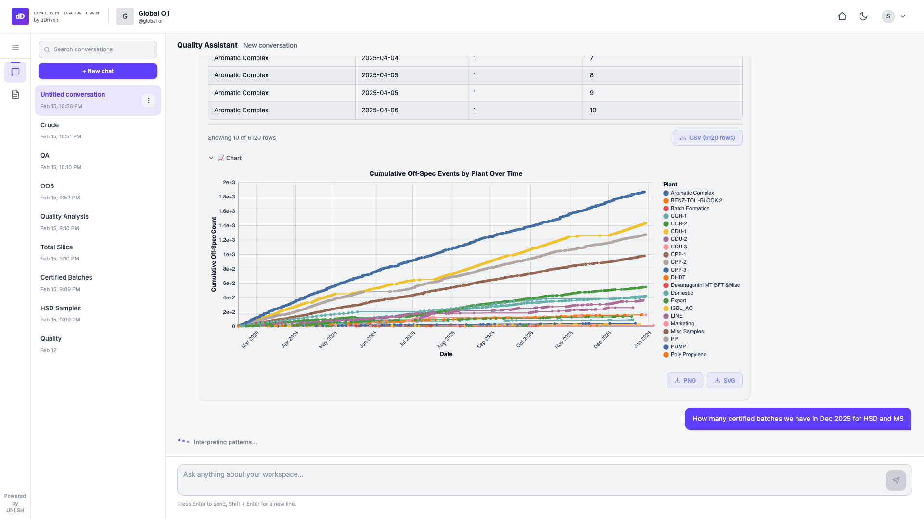
Solution (Agentic Interface) Example (Video) from a Large Indian Petroleum Refinery

Slide 11
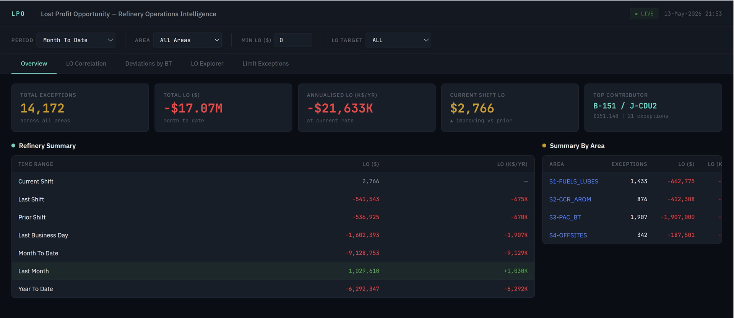
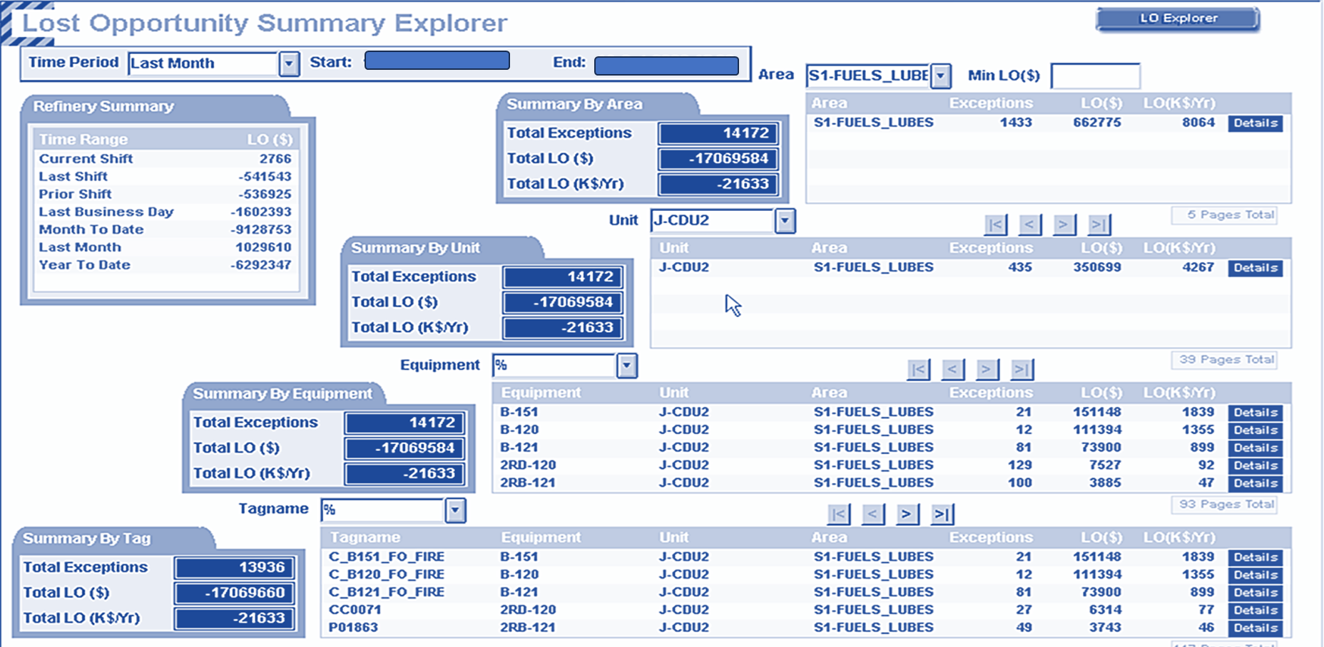
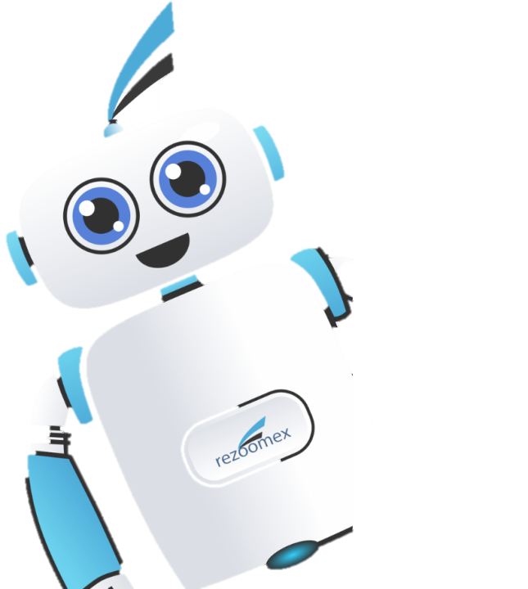
LPO: Capturing every Deviation, Exception, Excursion in Economic terms & Prioritizing
Now I can do it.

Slide 12
Partha.ray@dDriven.io

