Slide 1



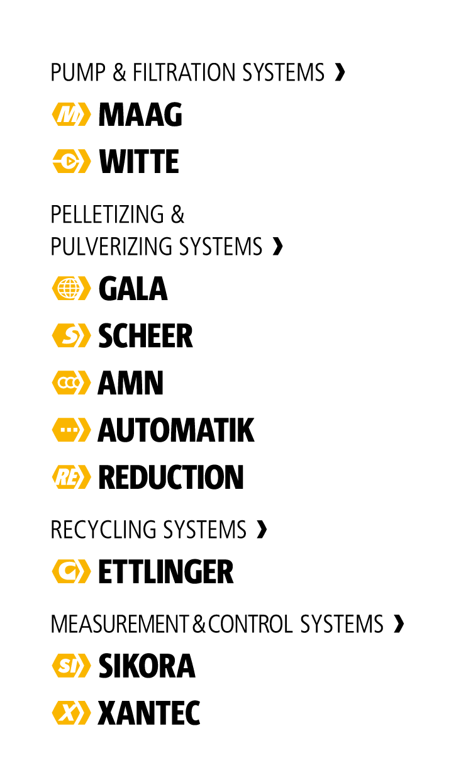


(c) MAAG Group

Slide 2

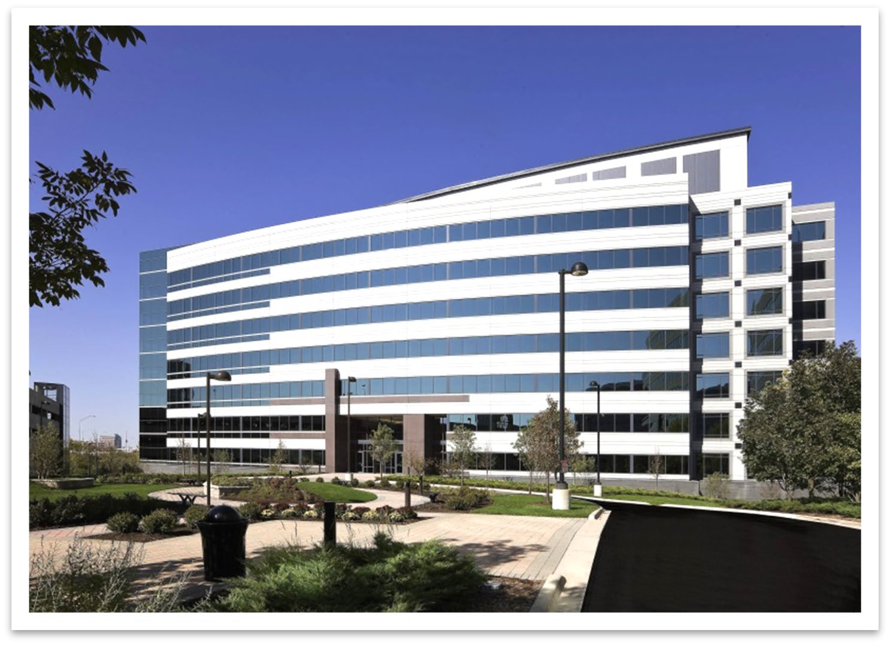
Dover Corporation
Founded in 1955, and headquartered in Downers Grove, Illinois, USA
Multibillion dollar diversified global manufacturer of industrial products (NYSE: DOV)
Over 25,000 employees with customers
in more than 100 countries with 18 operating companies
Organized into five market segments

Slide 3

Dover Corporation
Imaging & Identification
Engineered Products
Fueling Systems
Pumps & Process Solutions
Refrigeration & Food Equipment

Slide 4
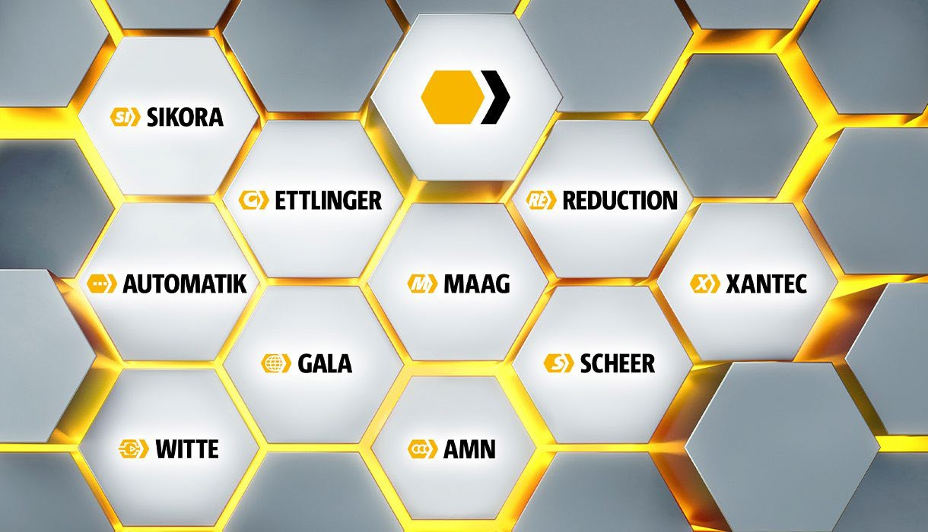
Inside MAAG
Maag Pump Systems founded in 1913
Headquartered in Oberglatt, Switzerland
Specialists in Plastics Processing
More than 1,900 employees worldwide
Global footprint with facilities in USA, Europe and Asia Pacific
Annual turnover 2025 ~ US$ 570 Mio.
Part of the Dover Corporation since 2012

Slide 5
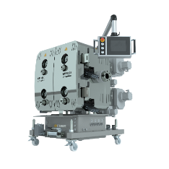
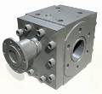
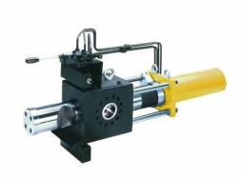
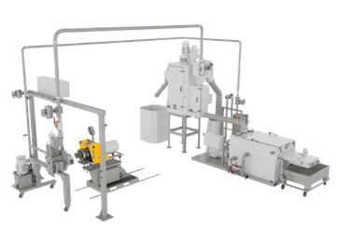
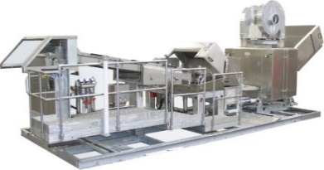

Fields of Competence
The brands you know, and trust have teamed up in four Fields of Competences,
to proudly build better solutions for your demanding applications.
MAAG as a “House of Brands”
Screen Changers
& Filters
Melt Pumps
Pulverizers
Pelletizers
Recycling
Systems
Digitalization

Slide 6
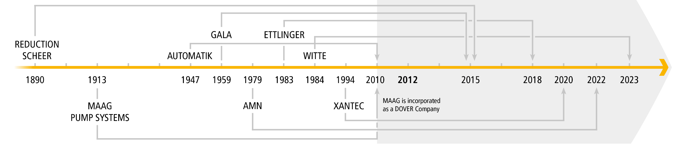

Historical Timeline
MAAG Group today is formed by eight successful and well experienced companies with an impressive heritage. Each of them brings a wealth of knowledge and years of experience. All eight have achieved much in the past and will achieve even more together in the future.

Slide 7











Wherever you are …
France
Port-Jérôme-Sur-Seine
Germany
Xanten
Germany
Kevelaer-Kervenheim
Germany
Tornesch
USA
Eagle Rock, VA
USA
Kent, OH
Germany
Grossostheim
Switzerland
Oberglatt
Germany
Königsbrunn
France
Villeurbanne
Italy
Rozzano
China
Shanghai
Location details
USA
Charlotte, NC
Taiwan
Taipei
India
Vadodara
Manufacturing
Sales
Malaysia
Kuala Lumpur
China
Guangzhou
Customer Service
Grinding Center
Brazil Sao Paulo
Test Center
Thailand
Chonburi

Slide 8
Enhancing plant operational efficiency and reliability with MAAG gear pump.

Slide 9
Index:
Pump definition & classification
Types of gear pump
Principle operation
Key challenges in chemical industries
Pump construction and parts & Clearances
Types of MAAG pumps
Pump Material
Pump Nomenclature
Pump skid & accessories
Advantages of gear pump
Application
Certification

Slide 10
Pump definition & classification
Definition:
A pump is a device that moves fluids by mechanical action.
Covert mechanical energy >> hydraulic energy
Pumps serve in a wide range of applications, there are practically no field of activity where a pump is not present.
From mechanical, chemicals, pharmaceutical, food, agriculture, automobile, energy, animal feed, medical, biology, entertainment, plastic,………and many others.

Slide 11
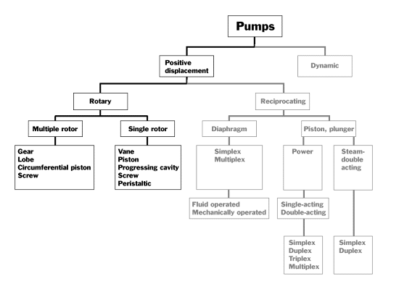
Pump definition & classification
Continued..

Slide 12
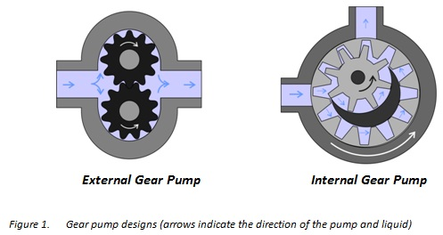
2. Types of gear pump
A gear pump is a type of positive displacement (PD) pump.
Two basic designs of gear pump:
External Gear : An external gear pump consists of two identical, interlocking gears supported by separate shafts. Generally, one gear is driven by a motor and this drives the other gear (the idler).
Internal Gear :An internal gear pump has two interlocking gears of different sizes with one rotating inside the other.

Slide 13
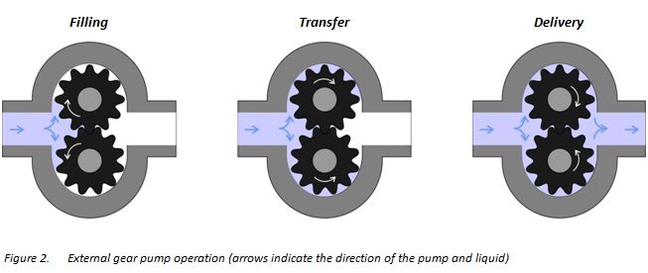
3. Principle operation
There are three stages in gear pump’s working cycle: filling, transfer and delivery
As the gears come out of mesh on the inlet side of the pump, they create an expanded volume. Liquid flows into the cavities and is trapped by the gear teeth as the gears continue to rotate against the pump casing.
The trapped fluid is moved from the inlet, to the discharge, around the casing.
As the teeth of the gears become interlocked on the discharge side of the pump, the volume is reduced and the fluid is forced out under pressure.

Slide 14
3. Principle operation…continued
No fluid is transferred back through the centre, between the gears, because they are interlocked. Close tolerances between the gears and the casing allow the pump to develop suction at the inlet and prevent fluid from leaking back from the discharge side (although leakage is more likely with low viscosity liquids).

Slide 15
4. Key challenges in chemical industries
1. Handling High Viscosity & Thick Fluids
The gear teeth create chambers that carry the thick liquid directly from the suction to the discharge side, enabling reliable transfer of viscous materials that would clog other types of pumps.
2. High-Pressure Stability & Precision Dosing
Chemical reactions often require precise additions of catalysts or reactants.
  Precision Metering: Gear pumps provide a constant flow rate that is directly proportional to their speed of rotation, allowing for accurate, repeatable dosing.
  High-Pressure Capability: Because they are positive displacement, they can operate against high pressures without significant changes to the flow rate, ensuring stability in complex reactor systems.
3. Resistance to Corrosion & Harsh Chemicals
Specialty chemical pumps are designed with materials that resist corrosion, such as SS 316L /Hastelloy/ Titanium allowing them to handle acidic, alkaline etc.
  Seal-less & Magnetic Drives: To prevent leakage of hazardous fluids, gear pumps are often configured with magnetic drives or canned motors, which create a fully sealed, leak-proof environment.
4. Handling Sensitive Fluids & Reducing Shearing
Gear pumps generate minimal shear forces, making them ideal for handling delicate polymers or chemical mixtures where damage to the fluid structure must be avoided.
5. Managing High Temperatures & Efficiencies
Gear pumps are built to withstand high temperatures and pressures common in petrochemical processes, with special materials that avoid degradation. They maintain high efficiency at low speeds, reducing energy wastage.

Slide 16
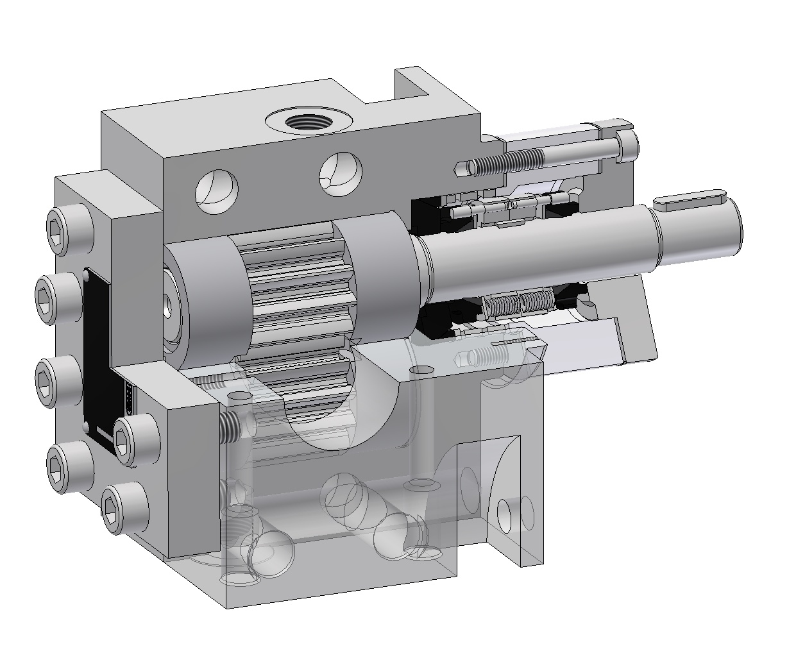
5. Pump construction, parts & clearances
Wide variety of Seals available
Housing
Journal Bearing
Drive Shaft
Housing with heating channels
Driven Shaft

Slide 17
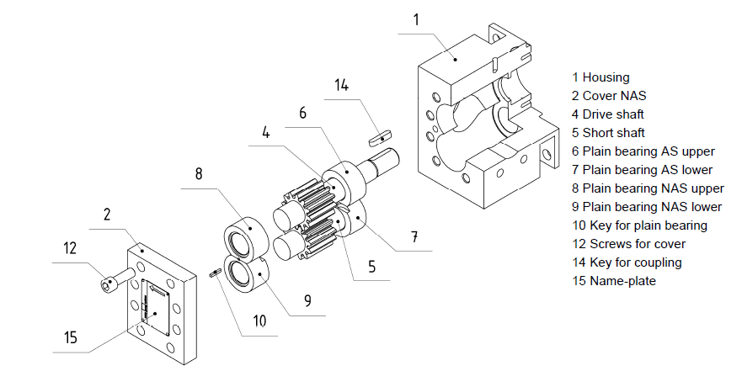
5. Pump construction, parts & clearances
continued..
Exploded view of gear pump

Slide 18
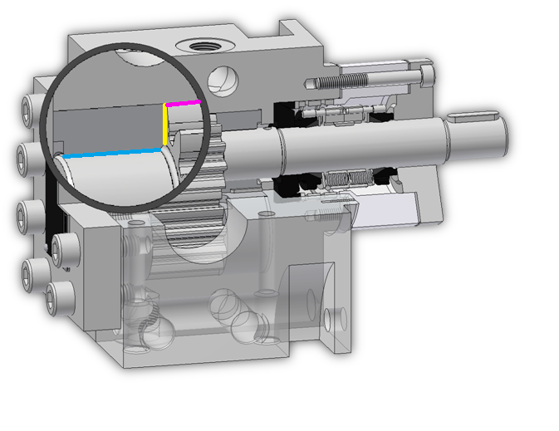
5. Pump construction, parts & clearances
continued..
Axial Clearance “A”
Radial Clearance “R”
Axial clearance ‘A’ (housing machining)
Housing depth - Bearings & shaft stack height
    Gear shaft tip diameter - Housing ID
    Gear shaft OD - Bearing’s ID
Journal Clearance “W”

Slide 19
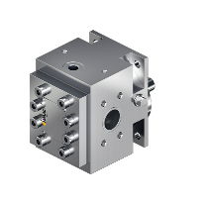
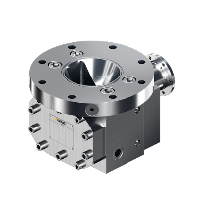
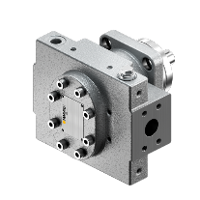
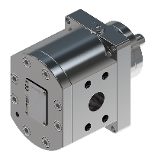
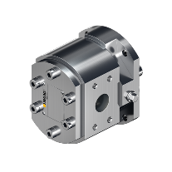
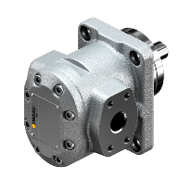
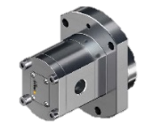






6. Types of MAAG Pump
Chemical
Resin
Plastics
Refinery
Lubrication
Food & Pharma
Therminox®
Cinox®
Stainless Steel
  Therminox®-V
  Cinox®-V
  Stainless Steel
  CHEM-XTM
  Stainless Steel
  DosixTM
  Stainless Steel
  Refitherm®
  Refinex®
  Cast steel
Hydrolub®
Cast Iron
  FlexinoxTM
  Stainless Steel
Chemical:
Acids
Solvents
Additives
Watery media, cooling media, Detergents
Paints varnishes
Flavors and fragrances
Molten sulfur
General
Resin:
Polyurethane, Isocyanate
Polyurethane, Polyol
Adhesives, Hotmelt
Epoxy Resin
General
Plastics:
Spandex
Carbon Fibers precursor
Prepolymers, oligomers and monomers
Cellulose derivatives and pulps
PVA / EVOH
General
Refinery:
Petrochemical products
Fuels
Bitumen, asphalt
Waxes and paraffins
Lubrication:
Lube oil
Mineral oils and fats
Silicones
General
Food & Pharma:
Food
Pharmaceutical products
Gum base
General
Notes:
As you see, CHEM-X application are exactly the same of its priedesessor.

Slide 20
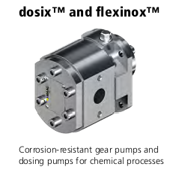
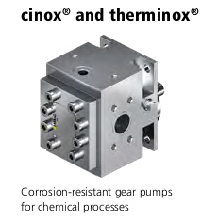
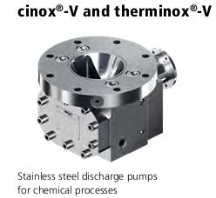
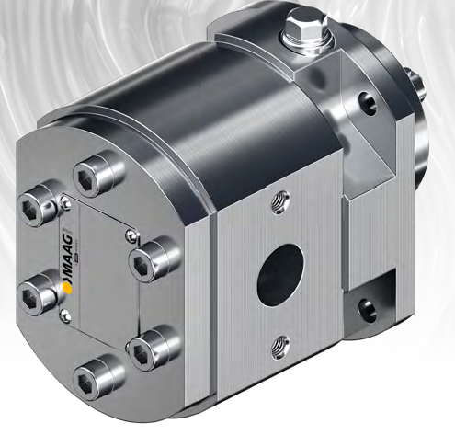
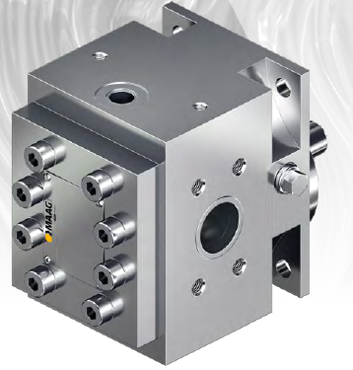
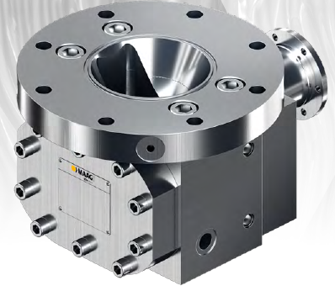



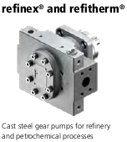
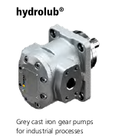
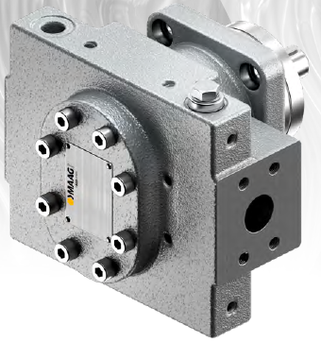
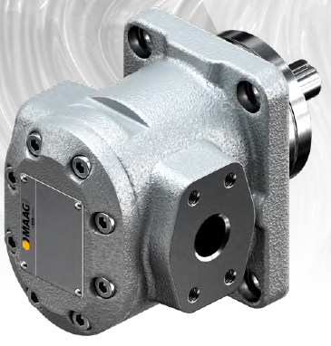
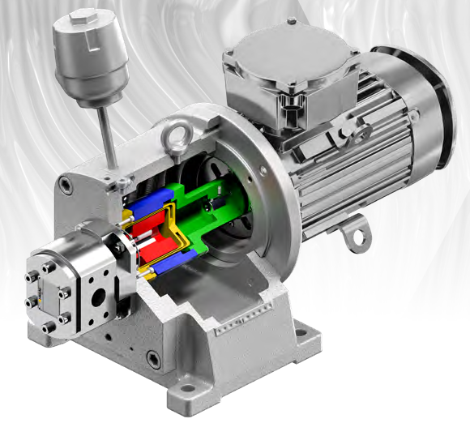



6. Types of MAAG pumps

Slide 21
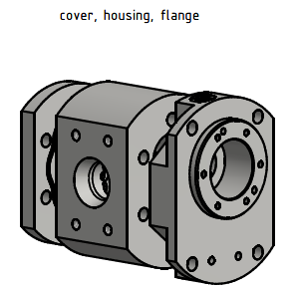
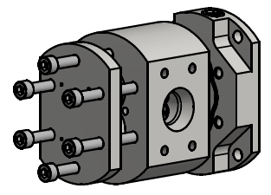
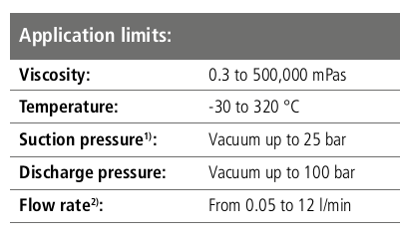
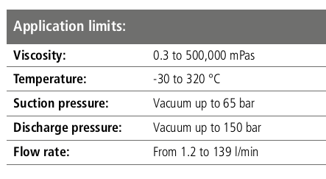
6. Types of MAAG pumps…Continued
DX
FX

Slide 22
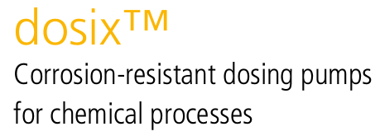
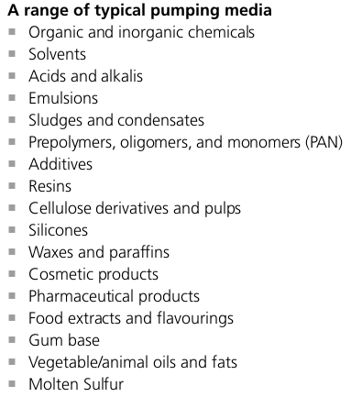
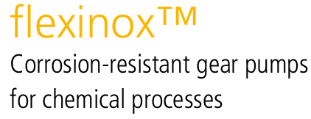
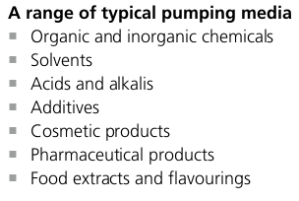
6. Types of MAAG pumps…Continued
FX-Pump
DX- Pump

Slide 23

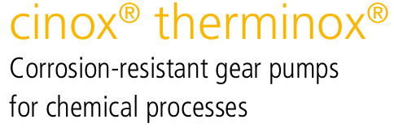
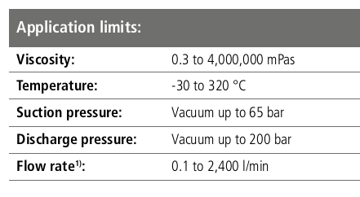
6. Types of MAAG pumps…Continued

Slide 24
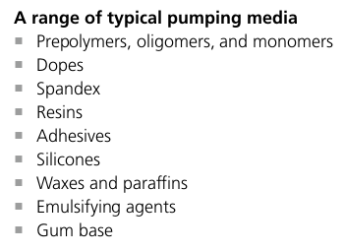
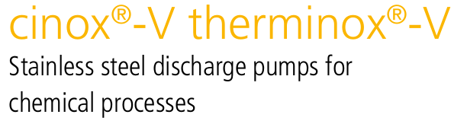
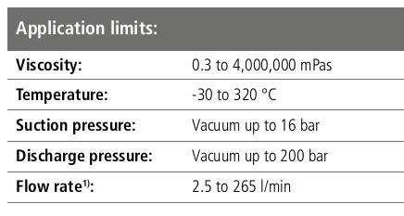
6. Types of MAAG pumps…Continued

Slide 25
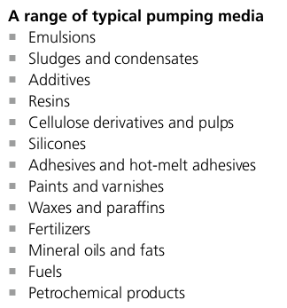
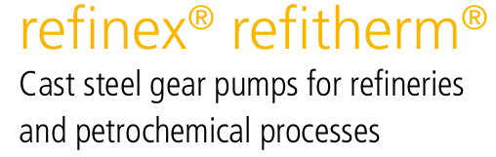
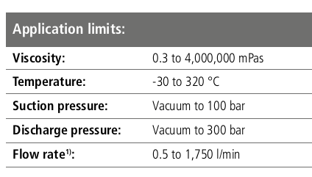
6. Types of MAAG pumps…Continued

Slide 26
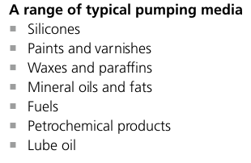


6. Types of MAAG pumps…Continued

Slide 27




6. Types of MAAG pumps…Continued

Slide 28
7. Pump Material
Housing
Bearings
  Stainless Steel
  Cast Iron
  Cast Steel
  Hastelloy
  Technopolymer (under development
  Steel / Bronze
  Sintered Iron
  Syntetic Carbon
  Steel with Carbon insert
  Nitrided Steel
  Nitrided Steel Coated
  Hardened tool Steel
  Bronze (Manganese bronze)
  AluBronze (CuAl)
  Silicium Carbide (SiSiC)
  Zirconia (ZrO2)
  NiAg (Nikel –Silver)
Gear Shafts
  Stainless Steel
  Nitrided Steel
  Nitrided Steel coated
  Ferralium
  Hastelloy
  Ceramic (SiSiC)
  Peek (on Request)
  Zirconium Oxide ZrO₂ (on request)
Certificates
Shaft Seal
  ATEX
  3.1 certificate
  TA-Luft
  API 676 3rd edition
  Lip seal
  Packing seal
  Single or Double Mechanical seal
  Different Seal API PLAN
  Seal ring from a range of materials
  Magnetic coupling with single or double containment shell
  Heated Seal

Slide 29
8. Pump Nomenclature
standard pump configuration
CX 36/36 A2W1R2 L Z35 L21 D6T.S ER ASMR PZ
Housing / type
Size
Clearances (A,W,R)
Rotation (L/R)
Gears type (Z)
Bearings type (L)
Seal type (D)
Remachining
Accessories
Extras

Slide 30


9. Pump skid & accessories

Slide 31








9. Pump skid & accessories
  1 Pump
  2 / 3 / 4 / 5 Pump Supports
  6 Coupling
  7 Motor
5
7
4
3
6
2
1

Slide 32
10. Advantages of MAAG gear pump
Low NPSHr
Corrosion resistance
Extensive portfolio of seals
In-house manufacturing of all core components
Easy maintenance and replacement of internal parts
Reliability and long life
Precise displacement volume
Energy efficient
Dosing accuracy
Less pulsation during pumping phase
Wider range of temperature, pressure and viscosity

Slide 33






11. Applications
  Organic chemicals
  Detergents, Additives, Alcohols,
  Acids, Phenols, Molten Sulphur
  Resin
  Detergents, Additives, Alcohols,
  Acids, Phenols, Molten Sulphur
  Lubrication
  Compressor Oil, Cooling Oil,
  Cutting Oil, Lubrication Oil, Processing Oil
Refinery products
Fuel oil, Diesel fuels, Naphta, Hydrocarbon, Asphalt, Bitumen
  Silicon
  Silicon Oil, Silicon general base
Plastic
Pre-polymers, Polymer solution, synthetic polymer emulsion, Oligomer,
carbon fibres

Slide 34


12. Certifications
API Q1
Lloyd
ATEX
ISO 9001 / 14001

Slide 35

Ausblick
Thank you for your attention
        iLobby für Besucher
Question time
35

Slide 36
Contact for your gear pump request :
Anand Deshpande
Email: anand.deshpande@maag.com
Mobile : +91 9619701424

